Slide 1


ZÁKLADNÍ ŠKOLA OLOMOUC příspěvková organizace MOZARTOVA 48, 779 00 OLOMOUC tel.: 585 427 142, 775 116 442; fax: 585 422 713 email: kundrum@centrum.cz; www.zs-mozartova.cz
Projekt: ŠKOLA RADOSTI, ŠKOLA KVALITY
Registrační číslo projektu: CZ.1.07/1.4.00/21.3688
EU PENÍZE ŠKOLÁM
Operační program Vzdělávání pro konkurenceschopnost

Slide 2
ZÁKLADNÍ ŠKOLA OLOMOUC příspěvková organizace MOZARTOVA 48, 779 00 OLOMOUC tel.: 585 427 142, 775 116 442; fax: 585 422 713 email: kundrum@centrum.cz; www.zs-mozartova.cz
Autor: | Mgr. Petra Doskočilová
Vzdělávací oblast: | Jazyk a jazyková komunikace
Vzdělávací obor: | Anglický jazyk
Vzdělávací předmět: | Anglický jazyk
Ročník: | 6.
Tematická oblast: | Gramatické jevy
Téma hodiny: | Past simple 1
Označení DUM: | VY_32_INOVACE_24.10.DOS.AJ.6
Vytvořeno: | 20. 01. 2014

Slide 3
Past simple 1

Slide 4
Past simple
= minulý čas prostý
verb „to be“
present
past
I am ill.
I was ill yesterday.
You are my friend.
You were my friend.
This skirt is dirty.
This skirt was dirty.
The children are at school .
The children were on holidays last week.

Slide 5

verb „to be“ - affirmative
I | was | at the cinema yesterday.
We You They | were | in Italy last year.
He She It | was | ill on Tuesday.

Slide 6

verb „to be“ - negative
I | was not wasn´t | with you on Friday.
We You They | were not weren´t | at the party last weekend.
He She It | was not wasn´t | at the shops yesterday.

Slide 7
Write the correct verb:
I ________ at my grandmother´s house last Christmas.
You _________ very sad last week. What happened?
We ___________in the museum on Monday. It ________closed.
She ___________ my best friend. Not now.
My mother and father __________ at work yesterday.
I ____________ at school last week. I _________ ill, I had a flu.
My friend Mel ________ so happy. She had a big birthday party.
Our neigbours ______________ at home two days ago. They __________ on holiday in Croatia.
was
were
weren´t
was
was
were
wasn´t
was
was
weren´t
were

Slide 8
verb „to be“ - questions
He was your teacher.
Was he your teacher?
Yes, he was.
No, he wasn´t.

Slide 9

Yes/no questions and short answers
I
Was I at the birthday party on Friday?
Yes, I was.
No, I wasn´t.

Slide 10
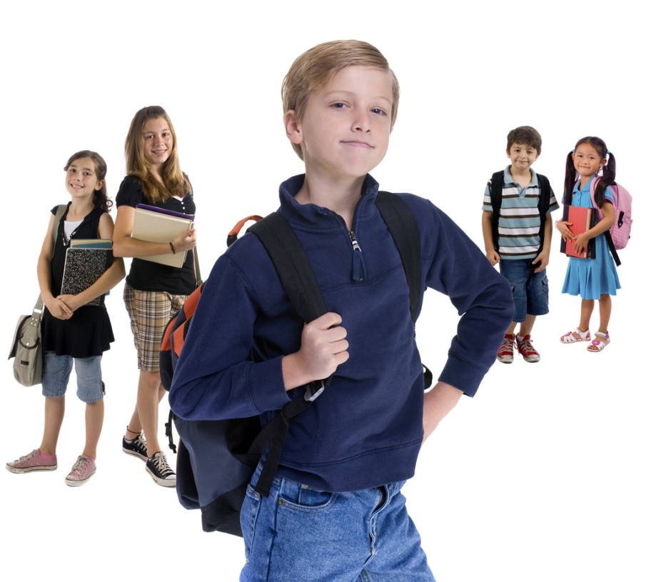
Yes/no questions and short answers
He, she, it
Was your brother at school yesterday?
Yes, he was.
No, he wasn´t.

Slide 11
Yes/no questions and short answers
you
Were you in Italy last holiday ?
Yes, I was.
Yes, we were.
No, I wasn´t.
No, we weren´t.

Slide 12
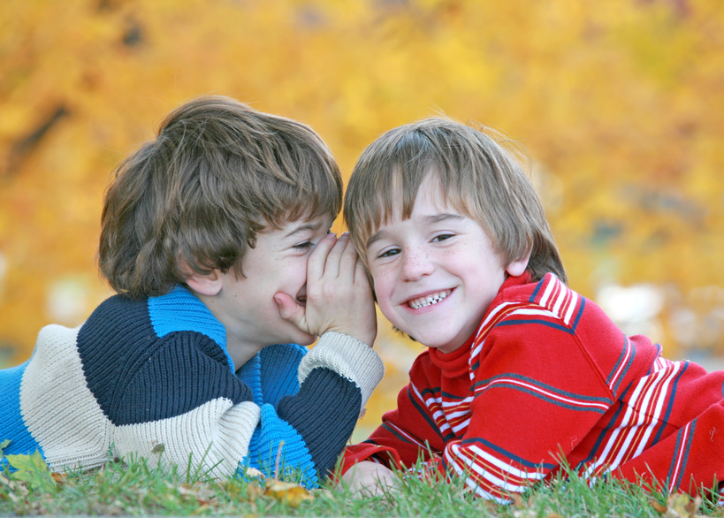
Yes/no questions and short answers
we, they
Were Peter and John at the park two days ago?
Yes, they were.
No, they weren´t.

Slide 13
Answer the questions, use short answers:
Were you at the dentist last month?
Were you and your friends at the cinema last week?
Was your mother at the shop on Saturday?
Were you ill last three months?
Was your best friend at your house last week?
Were you at school yesterday?
Were you on holiday last summer?
Was your teacher happy last lesson?

Slide 14
ZÁKLADNÍ ŠKOLA OLOMOUC příspěvková organizace MOZARTOVA 48, 779 00 OLOMOUC tel.: 585 427 142, 775 116 442; fax: 585 422 713 email: kundrum@centrum.cz; www.zs-mozartova.cz
Seznam použité literatury a pramenů:
HUTCHINSON, T. Project 2 – třetí vydání. Oxford : OUP, 2008. ISBN 978-0-19-476415-5. s. 32 - 33.
Nečíslovaný obrazový materiál je použit z galerie obrázků a klipartů Microsoft Office.

